Slide 1
Integrated Information Decreases in Flies
Angus Leung
2018-06-06

Slide 2
Overview
Integrated Information Φ
Applying Φ to fly data
Effects of anaesthesia on Φ
Pattern of Φ in fly data
Classifying conscious level using Φ
A little extra

Slide 3
Integrated Information Theory
Consciousness arises in networks which are integrated and informative
Integration
i.e. non-reducibility
Information
i.e. differentiability
Integrated information Φ

Slide 4
What is Integrated Information Φ?
Integrated O
Information |
O = exists only when considering the whole
O = reduction due to splitting
I = reduction in uncertainty
Uncertainty: a neuron can be firing or not firing
The Whole
Yes
No
Some other neuron
1 neuron, 2 possible states
Notes:
So what is integrated information?
Information can be understood as a reduction in uncertainty. What do I mean by uncertainty? Well, given a neuron, there is uncertainty at a given time as to whether it is firing, or not.
If we consider another neuron, such that our original neuron fires when the new one fires, then knowing that the new one means that the first one must also be firing – we thus have a reduction in uncertainty from 2 possible states to 1 possible state – this reduction is information. You can think of it as knowledge about the new neuron constraining the possibilities of the first neuron.
Integration refers to something that exists only when considering the whole – for integrated information, this refers to the information gained (or uncertainty reduced) when considering the whole system. To assess this, we can find the information gained from a split system, for example if we ignore the connection between the two neurons, then our uncertainty as to the state of the first neuron returns to what it was before. So in this example, the information is integrated.
Uncertainty – the number of possibilities
The larger the reduction, the greater the information
When considering a lot of neurons, there are many many possibilities, so high uncertainty
Reduction in uncertainty after we know another neuron and its interaction with the current neuron
“Some other neuron can be the same neuron at a different timepoint”
Note this is a unidirectional example
Phi = reduction in information after splitting a system

Slide 5
What is Integrated Information Φ?
Does a given a system state (e.g. state of all neurons in the brain) constrain the possible past and future network states?
Yes – constrained states = reduced uncertainty = information
No – states unconstrained = same uncertainty = no information
Does splitting the network (e.g. brain into two hemispheres) give us the same information as not splitting the network?
Yes – no integration
No – integration is a vital part of the system – difference in information is Φ
Notes:
If we extend this to a larger system, or network, such as the brain, then the assessment of integrated information is akin to asking two questions:
Does the state of the network, in other words the states of all its elements, constrain the states it may take in the future, and is it informative as to what states it could have been in the past?
If there is information, how much of this information is integrated? If a split system generates the same amount of information, then the whole network reduces to independent networks.

Slide 6
What is Integrated Information Φ?
The current system state gives information about its past
There is a probability distribution of past states
The current states of parts of the system (i.e. each part of a split system) gives information about their pasts
There is a probability distribution of past states for each part

Slide 7
Φ^{3.0} vs Φ*
Φ* based on IIT 2.0
Assesses information the current state gives on possible past states
Compares probability distributions using mismatched decoding
Cheaper to compute (given certain assumptions of data)
Φ^{3.0} based on IIT 3.0 (latest version of IIT)
Assesses information the current state gives on possible pasts AND futures
Compares probability distributions using earth mover’s distance (EMD)
High algorithmic complexity (costly to compute)
Notes:
Sidenote – EMD allows Φ to behave as a metric (symmetric distances, etc) – mismatched decoding which uses KL divergence is not a metric

Slide 8
Integrated Information in Flies
Here we apply Φ^{3.0} and Φ* to flies
The fly model is a potentially good avenue – fly brain is much simpler than mammalian brain, yet flies still exhibit wide variety of complex behaviours

Slide 9
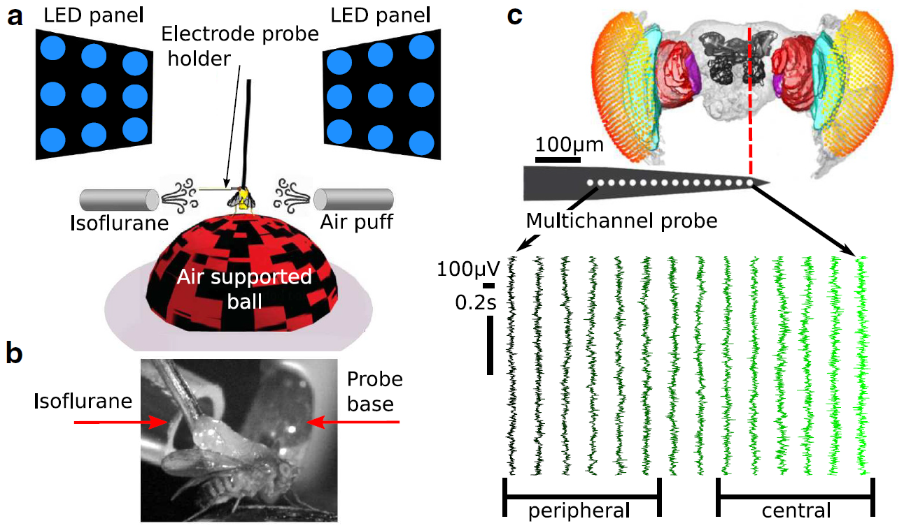
Fly Data
13 fruit flies (Drosphila melanogaster)
Half-brain probe: 16 electrodes
15 ‘channels’ after bipolar re-referencing
2 conditions:
0% isoflurane (air)
0.6% isoflurane (iso)
18s of ‘spontaneous’ LFP
18s period between an air puff and a visual stimulus block (irrelevant to this project)
18s period split into 8 x 2.25s trials
Notes:
Figure shows 14 bipolar rereferenced channels (the most peripheral was discarded, but it hasn’t been discarded in this analysis)
Recorded at 25kHz, downsampled to 1kHz
Air puff is ~180s after onset of isoflurane delivery
electrodes – 25micrometer separation, total length 375micrometers (base to tip)

Slide 10
Experimental Setup

Slide 11
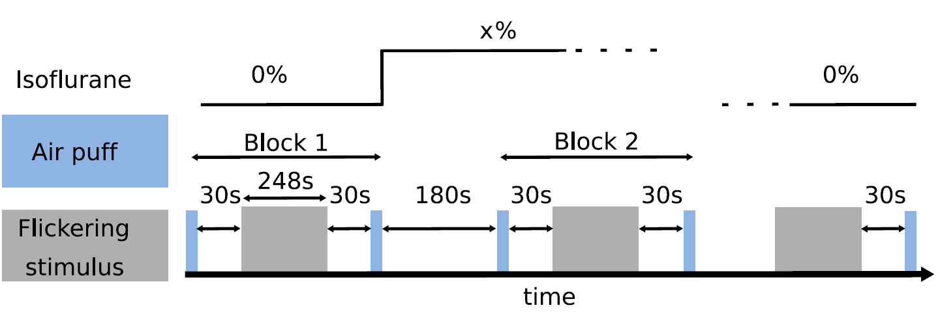
Experimental Protocol
Notes:
Diagram is wrong – 30s gaps should be 18s gaps
Our 18s corresponds to the 18s after air puff and BEFORE stimulus

Slide 12
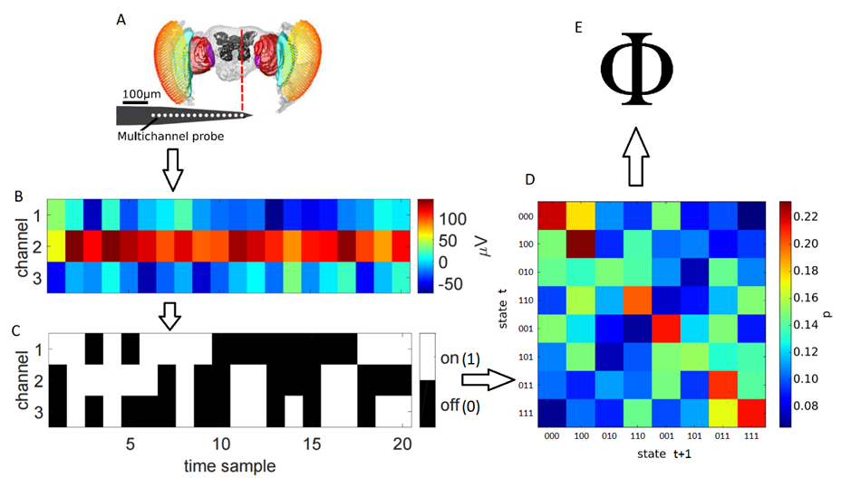
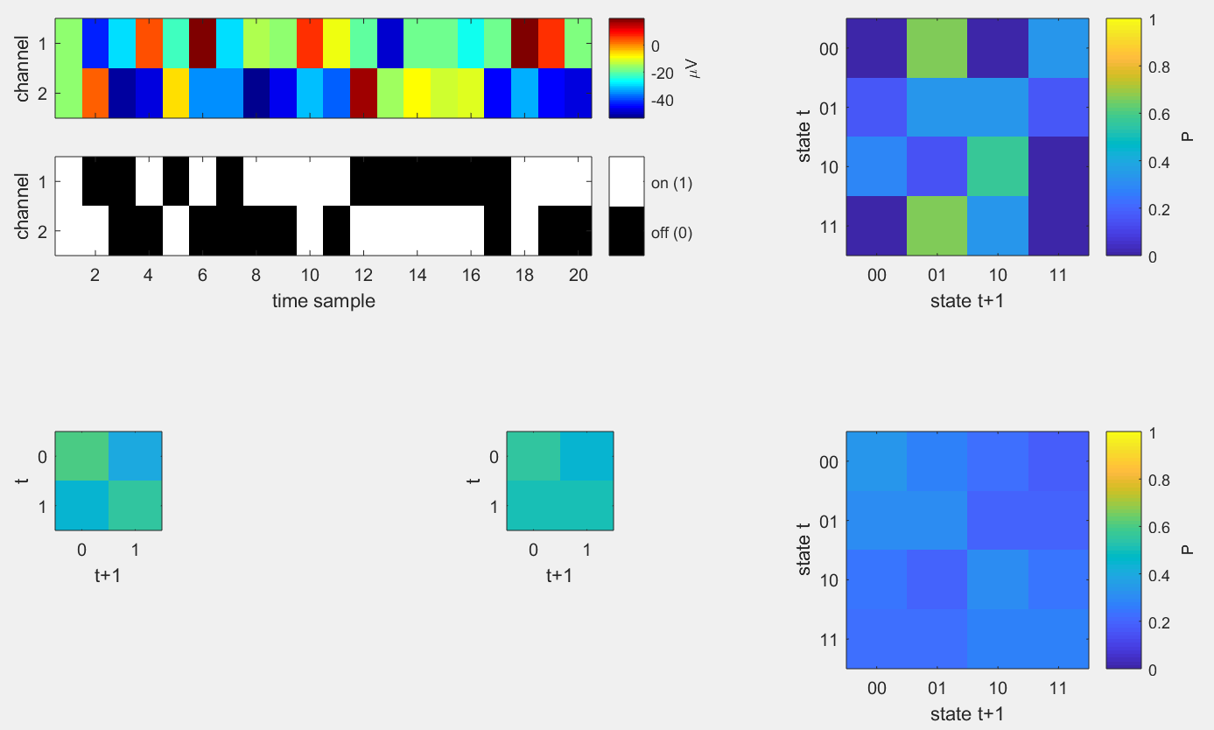
Measuring Φ in Flies
A
E
B
D
C
Notes:
Using these recordings, I calculated phi across different sets of channels.
From some set of channels, we can calculate a phi value.
Here I have the processing pipeline for a sample set of 3 channels. For each channel, I binarized its recording based on its median value across trials – if a sample was above the median, it was classed as ON, and otherwise OFF. Binarising the recordings in this manner allows us to obtain 2 things:
In C, every column thus gives the state of the network at a given time sample.
By looking across time samples, we can also obtain the empirical probabilities of each state transitioning into another state, which we store in a transition probability matrix, as in D. Knowledge of state transition probabilities allows us to assess the information generated by a given state, and factorisation of the matrix allows us to conceptually split the system in order to compare the information generated by the system at a given time sample against that generated by a split system.
Finally, I used a Python toolbox which essentially calculated phi, when given a system state and a transition probability matrix. As each trial contains many states, I average phi across all states, weighting by the number of times each state occurs within the trial to obtain a single phi value for the trial.
Phi requires discretised variables
LFPs binarised using global (across trials) median split
TPM constructed across trials – this is what allows for the quantification of uncertainty and information
Given a state and the TPM, we can get a phi value and associated MIP per sample (via pyphi)
Phi per trial is averaged across samples, weighting for frequency of state occurrences

Slide 13
Measuring Φ in Flies
Full
Split
Channel 1
Channel 2
⊗
Notes:
Phi-three

Slide 14
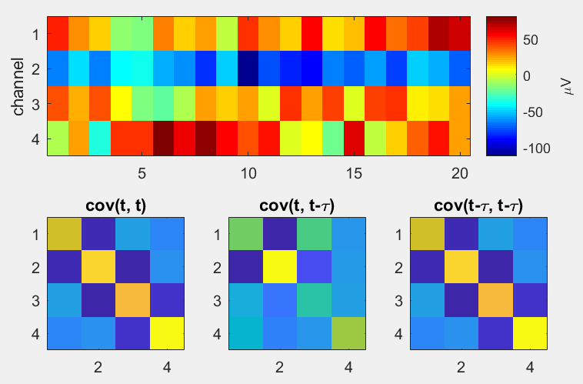
Φ* Calculation
Φ*
mismatched decoding (phi_toolbox, Oizumi)
Notes:
Normalisation factor seems to be number of groups in partition * minimum past entropy of the groups

Slide 15
Φ Parameters
Which channels to use?
15 choose 2 = 105 sets
15 choose 3 = 455 sets
15 choose 4 = 1365 sets
15 choose 5 = 3003 sets
Scale of transition probabilities?
τ = 4 ms, 8 ms, 16 ms
4 ms: for a state at sample t, probability of sample t+4 being a specific state
IIT: consciousness flows at a particular speed (where Φ is max)
Notes:
I didn’t choose – I calculated across all combinations of channels consisting up to 4 channels.
Why not more? Because computational (and memory) costs for computing phi grows exponentially with the number of elements in the system. Compounding this is the combinatorial growth of possible channel combinations. We experienced roughly 50x increase in computation time for each calculation of Φ as we increase channel set size (upper bound estimate of 1cpu*5mins per 4ch up to 8cpus*30mins per 5ch)
And what about the scale of transition probabilities? Do I calculate using probabilities with a 1 ms delay? Or a 20 ms delay? Given no testing of phi in the past, virtually any choice is arbitrary at this stage. So I chose calculate phi at 3 lags.
Finally, IIT states that phi should be computed at the temporal resolution which maximises phi. It’s unclear what this resolution is, so I calculated phi at 3 different temporal resolutions. The selected resolution changes only the transition probability matrix – for example, with a transition resolution of 4ms, I consider the probabilities of each state transferring to another state after a lag of 4ms have passed.
Phi-3 calculated with pyphi
Phi-star calculated using Haun’s functions
Choice of discretisation method seems arbitrary
Repeat tests for each parameter setting

Slide 16
Data Summary
N = 13 flies
15 channels per fly
105, 455, 1365 channel sets
2 conditions
8 x 2.25 s trials awake
8 x 2.25 s trials anaesthetised
2250 samples per trial
Φ : τ = 4 ms, 8 ms, 16 ms

Slide 17
Effect of Anaesthesia
TODO: Update phi-3 to show 2.25s TPM results

Slide 18
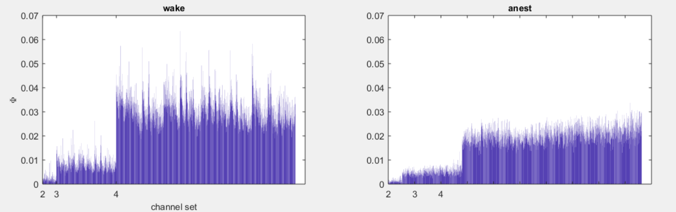
Φ^{3.0} values for 1 fly, τ = 4 ms
Notes:
Here are some results for a single fly, at one lag parameter.
To the left are the phi values in the air condition, and to the right are phi values during anaesthesia.
On the x axis we have the candidate systems, sorted by number of channels in the system, and within that, sorted from those which contain more peripheral channels to those with more central channels.
So each vertical bar gives the phi value, averaged across trials, for a given set of channels.
Results for 1 fly, at tau = 4ms

Slide 19
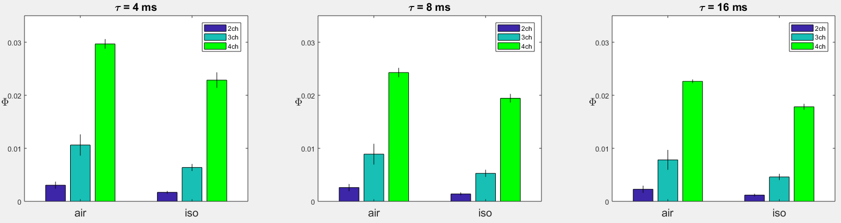
Φ^{3.0} values across flies
Notes:
NOTE: 4ch is mean and std error of 3 flies
If we average each the phi values across all channel sets, then across flies…
Here we see that larger networks yield larger phi
But more importantly, there is a significant reduction in phi during anaesthesia

Slide 20
Φ^{3.0} values across flies
Notes:
NOTE: 4ch is mean and std error of 3 flies
If we average each the phi values across all channel sets, then across flies…
Here we see that larger networks yield larger phi
But more importantly, there is a significant reduction in phi during anaesthesia

Slide 21
Φ^{3.0} values across flies
Notes:
NOTE: 4ch is mean and std error of 3 flies
If we average each the phi values across all channel sets, then across flies…
Here we see that larger networks yield larger phi
But more importantly, there is a significant reduction in phi during anaesthesia

Slide 22
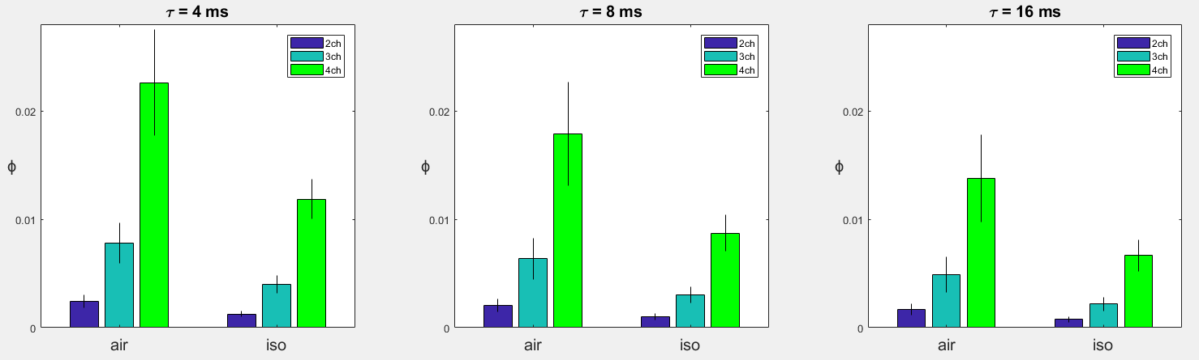
Φ values across flies
Notes:
If we average each the phi values across all channel sets, then across flies…
Here we see that larger networks yield larger phi
But more importantly, there is a significant reduction in phi during anaesthesia

Slide 23
Φ^{3.0} values across flies

Slide 24
Φ^{3.0} values across flies

Slide 25
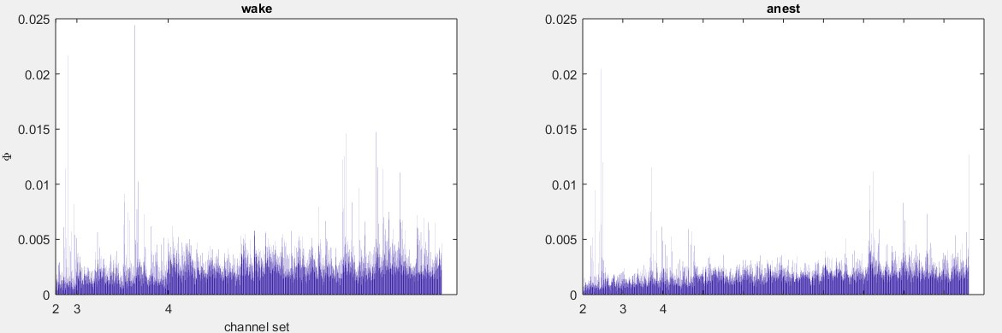
Φ* values for 1 fly, τ = 4 ms

Slide 26
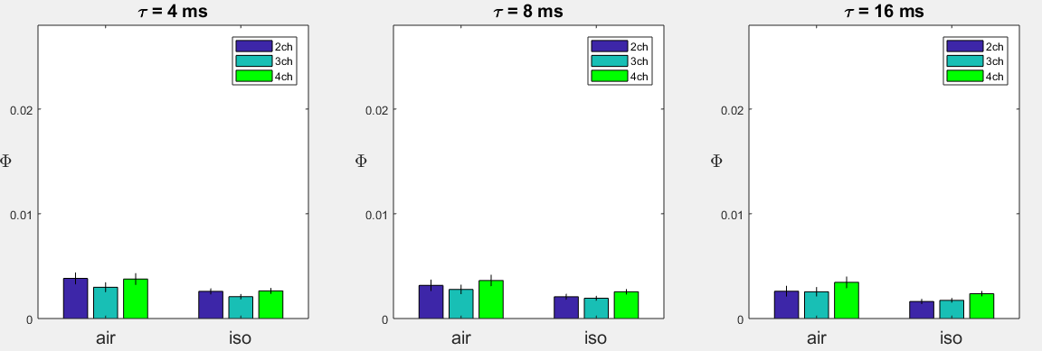
Φ* values across flies
Notes:
If we average each the phi values across all channel sets, then across flies…
Here we see that larger networks yield larger phi
But more importantly, there is a significant reduction in phi during anaesthesia

Slide 27
Φ* values across flies
Notes:
If we average each the phi values across all channel sets, then across flies…
Here we see that larger networks yield larger phi
But more importantly, there is a significant reduction in phi during anaesthesia

Slide 28
Φ* values across flies
Notes:
If we average each the phi values across all channel sets, then across flies…
Here we see that larger networks yield larger phi
But more importantly, there is a significant reduction in phi during anaesthesia

Slide 29
So far
Reduction in Φ^{3.0} during anaesthesia
Largest Φ at τ = 4 ms
From here on we focus on 4 ms

Slide 30
Spatial Pattern of Φ

Slide 31
How to visualise spatial features of sets?
How does Φ change with set location?
2 channels – 2 dimensions (ok)
{x, y} = {ch1, ch2}
3 channels – 3 dimensions (ok, but we have a 2D screen)
{x, y, z} = {ch1, ch2, ch3}
4 channels – 4 dimensions (!?)
{x, y, z, a} = {ch1, ch2, ch3, ch4}

Slide 32
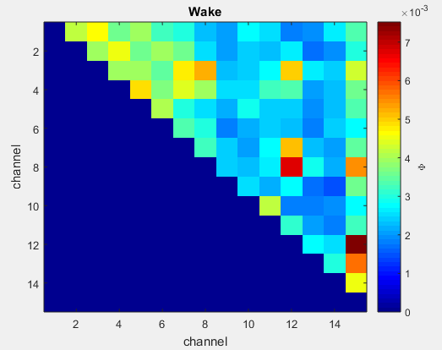
Notes:
Idea is just to show channel set ‘location’ mapping
These are phi3 wake values

Slide 33
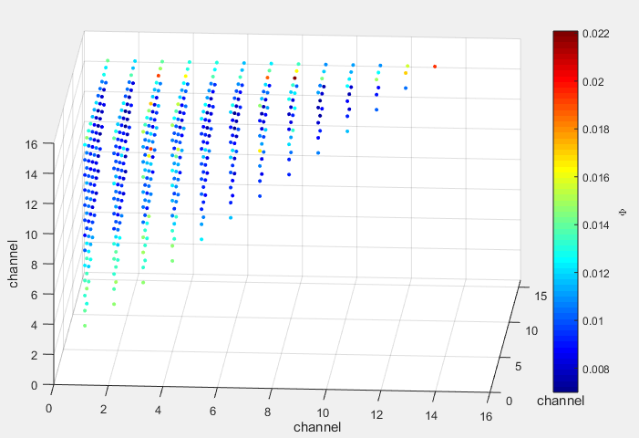
Notes:
Phi-3 wake values

Slide 34
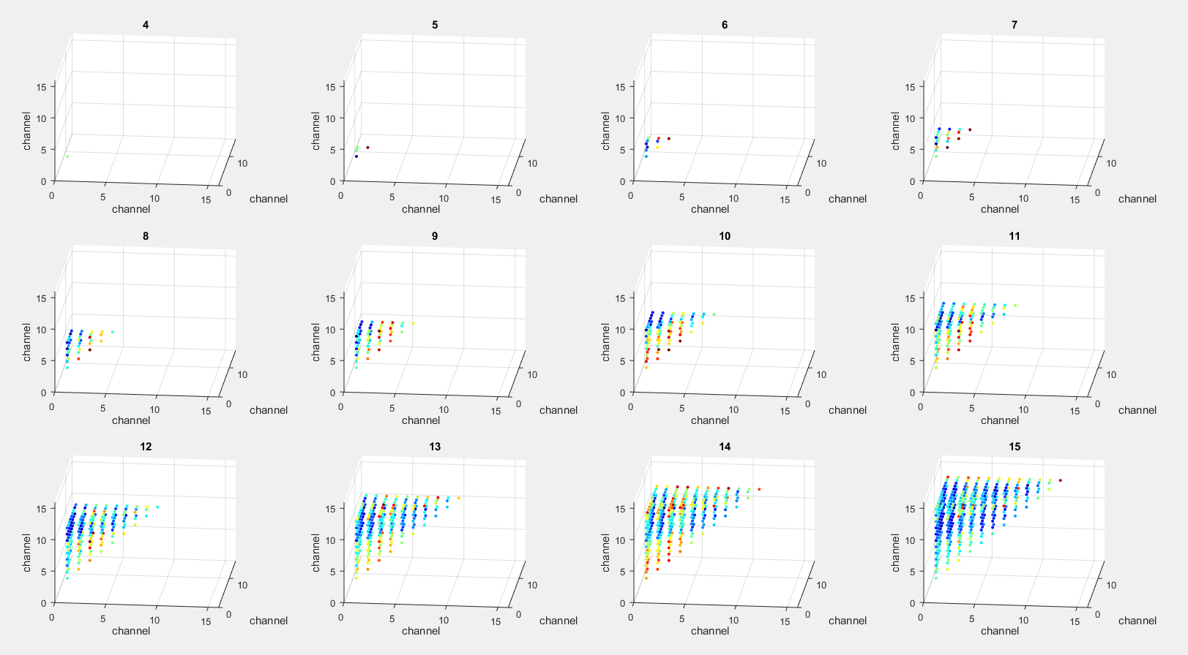
Notes:
phi-3 wake values

Slide 35
Channel Set Features
Reduce to 2 features/dimensions
Centre of channel set
e.g. centre( {1,2,3,4} ) = 2.5
Total distance among channels in set
e.g. dist( {1,2,3,4} ) = (2-1) + (3-1) + (4-1) + ... + (4-3) = 10
High correlation of centre and distance with first 2 principal components of 2, 3, 4D spaces
Centre: r = 1, .998, .996 (2, 3, 4 channels, PC1)
Distance: r = 1, 1, .99 (2, 3, 4 channels, PC2)

Slide 36
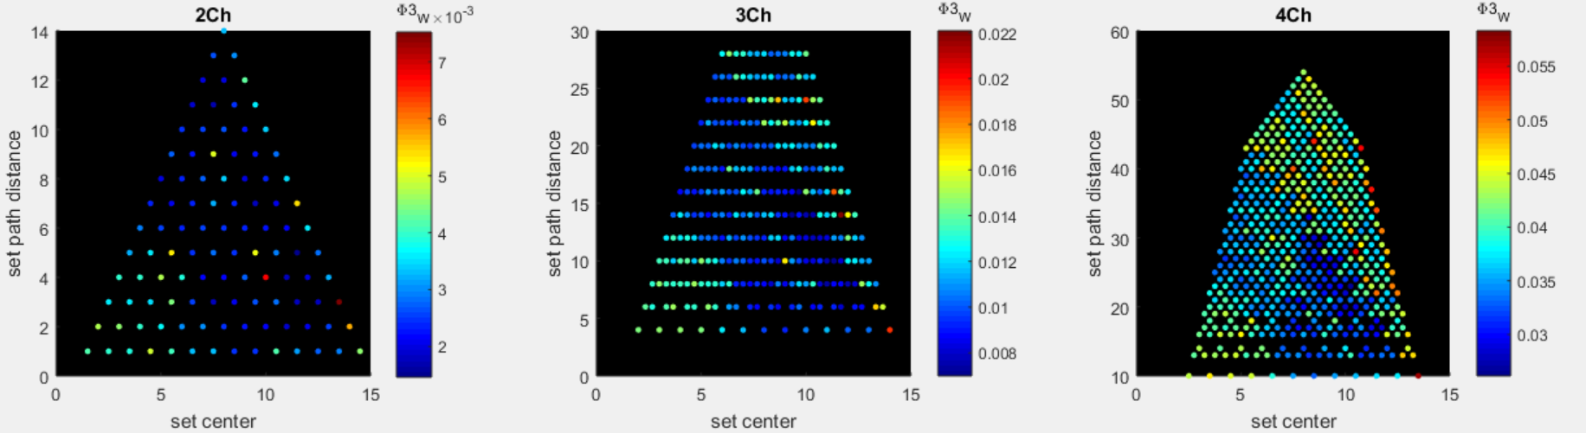
Awake

Slide 37
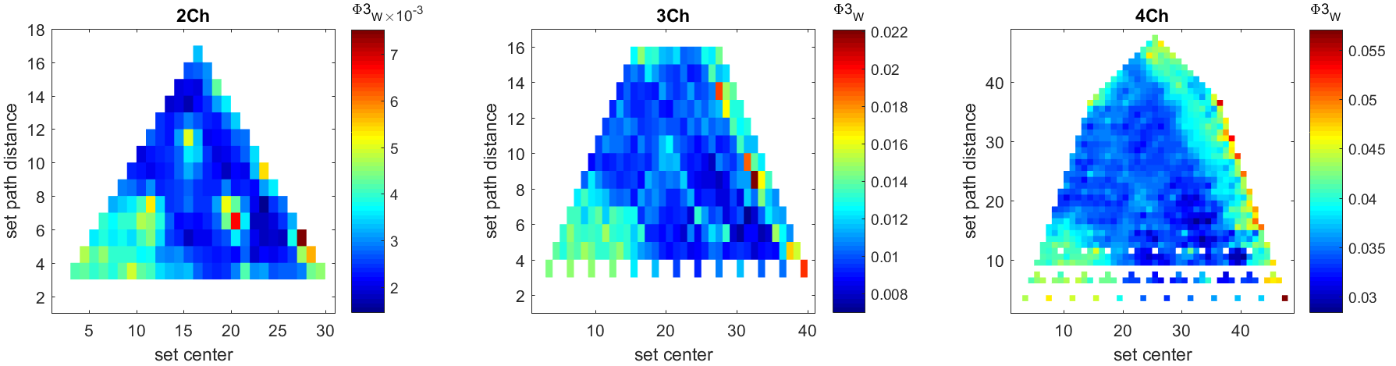
Φ^{3.0} Wake

Slide 38
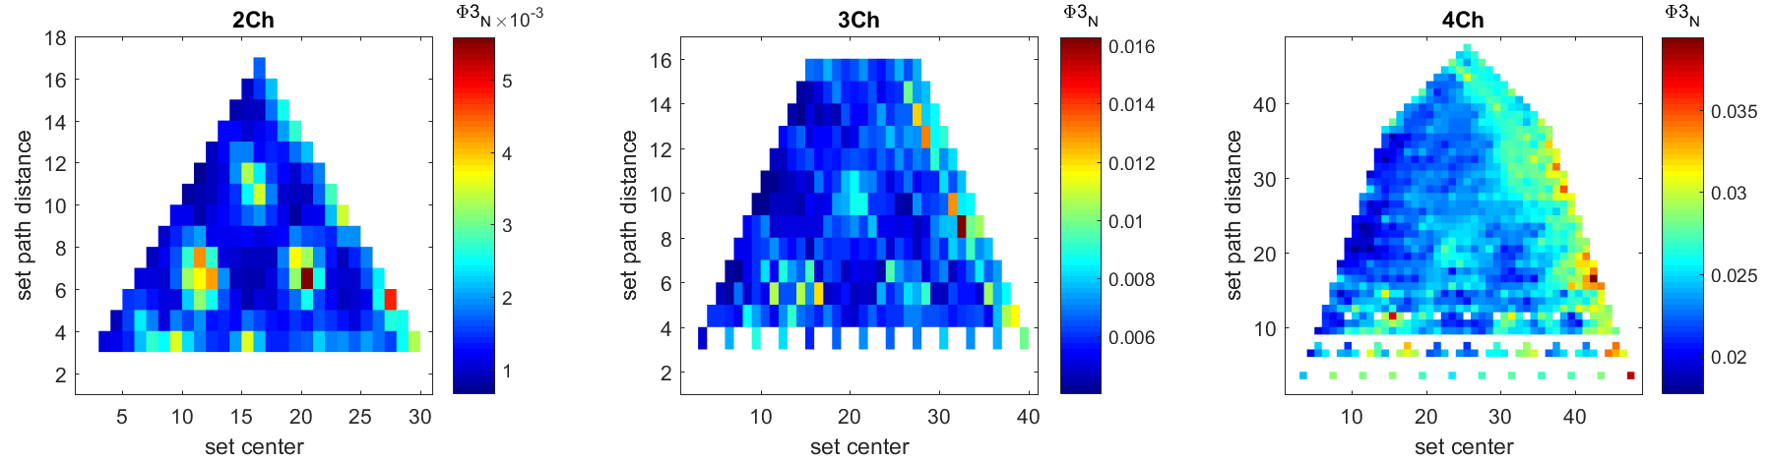
Φ^{3.0} Anest

Slide 39
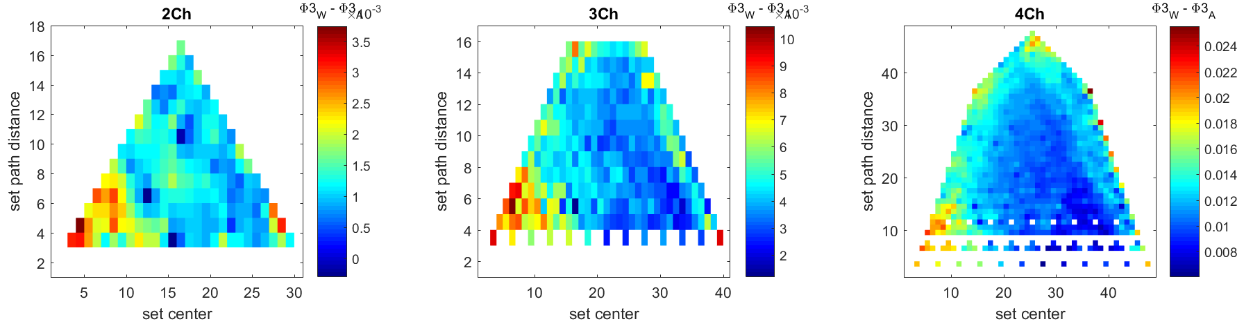
Φ^{3.0} Wake - Anest

Slide 40
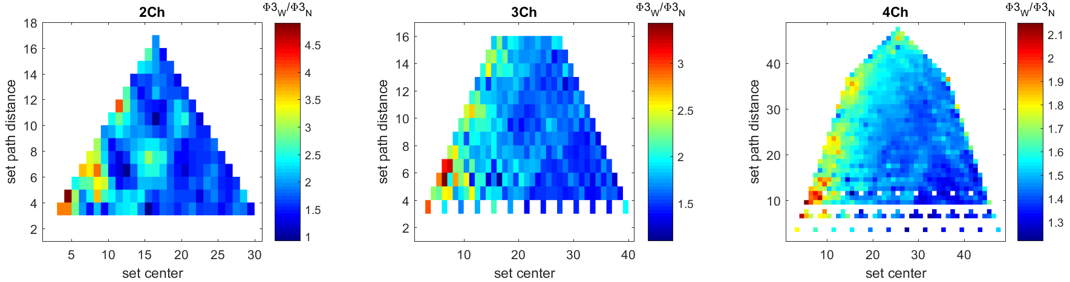
Φ^{3.0} Wake / Anest

Slide 41
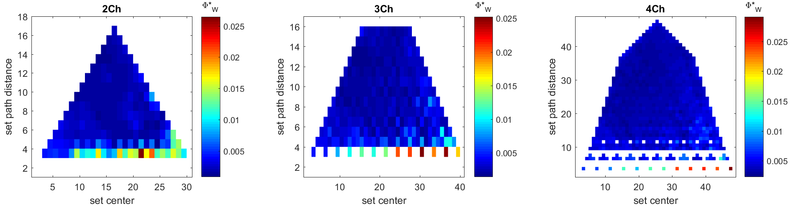
Φ* Wake

Slide 42
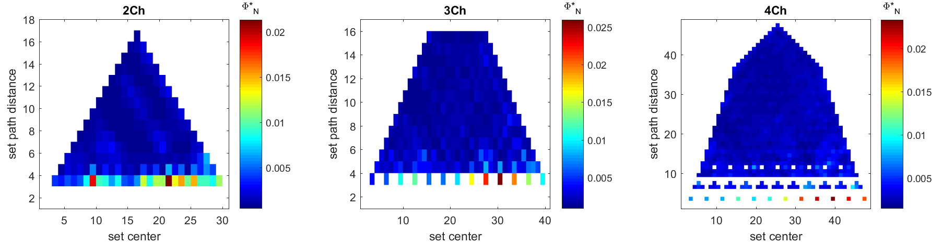
Φ* Anest

Slide 43
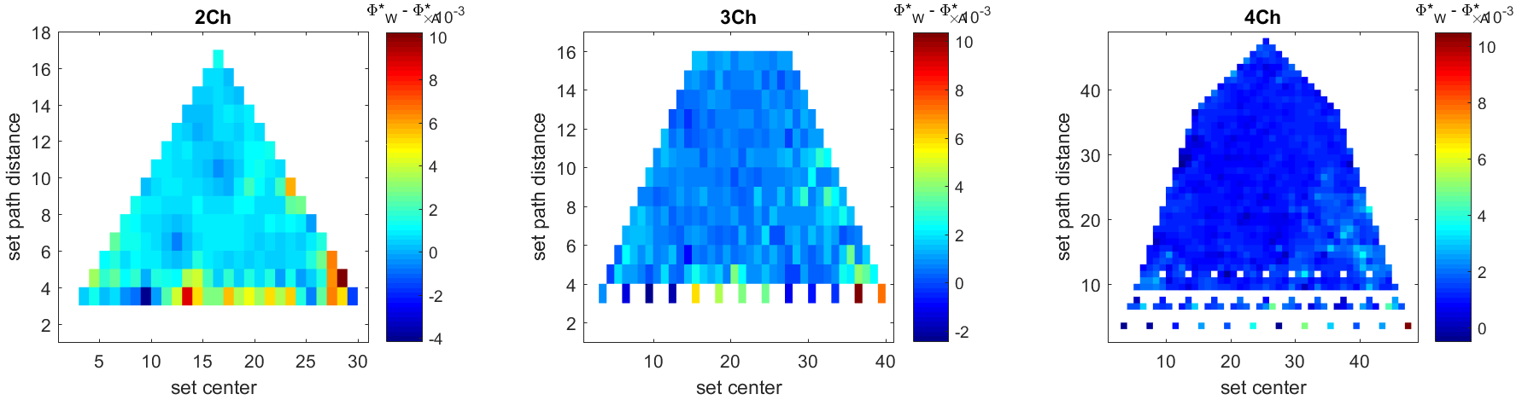
Φ* Wake - Anest

Slide 44
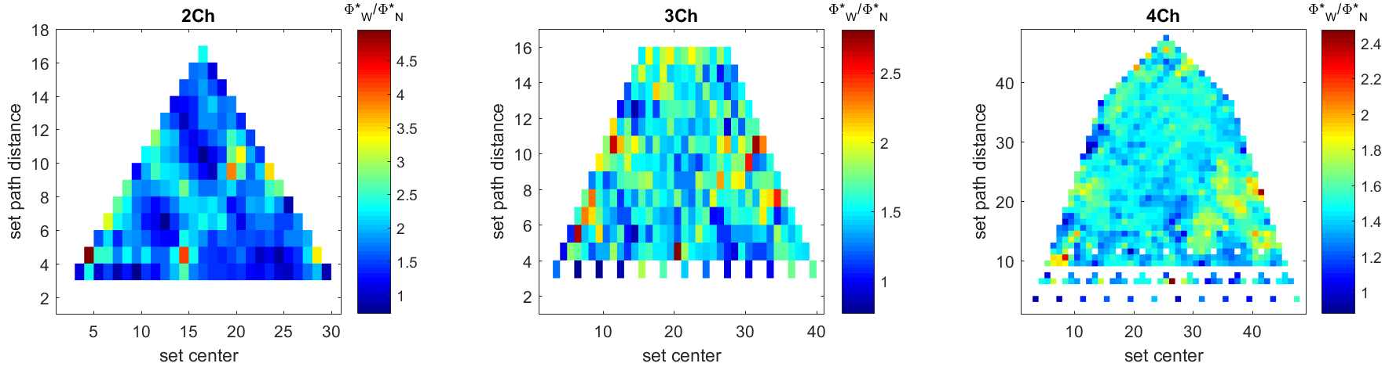
Φ* Wake / Anest

Slide 45
Φ Classification

Slide 46
Data Summary
N = 13 flies
15 channels per fly
105, 455, 1365 channel sets
2 conditions
8 x 2.25 s trials awake
8 x 2.25 s trials anaesthetised
2250 samples per trial
Φ : τ = 4 ms, 8 ms, 16 ms

Slide 47
Φ classification
Can we use Φ to classify conscious level?
Classify using Φ at each channel set
8 values per condition
Leave-one-out classification (per fly, channel set)
Remove trial pair – use as test pair (8*8 test pairs)
Find wake/anest means using remaining 14 trials
Classify test pair using nearest mean

Slide 48
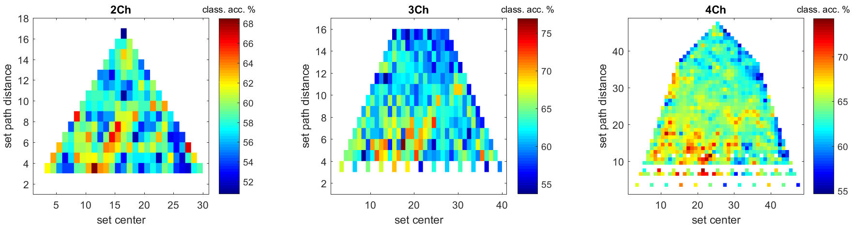
Φ^{3.0} classification
Notes:
Averaged across flies

Slide 49
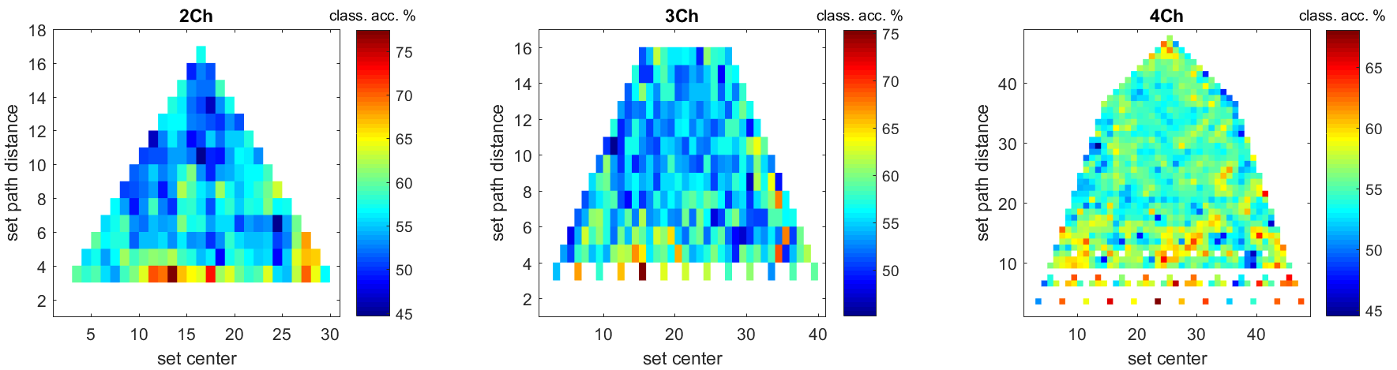
Φ* classification
Notes:
Averaged across flies

Slide 50
Φ classification across flies
Can we use Φ to classify across flies?
Compute Φ^{3.0} and Φ* across full 18s period
1 trial per fly/condition
Leave-one-out classification (per channel set)
Classification across 13 flies (13*13 leave-out-pairs)

Slide 51
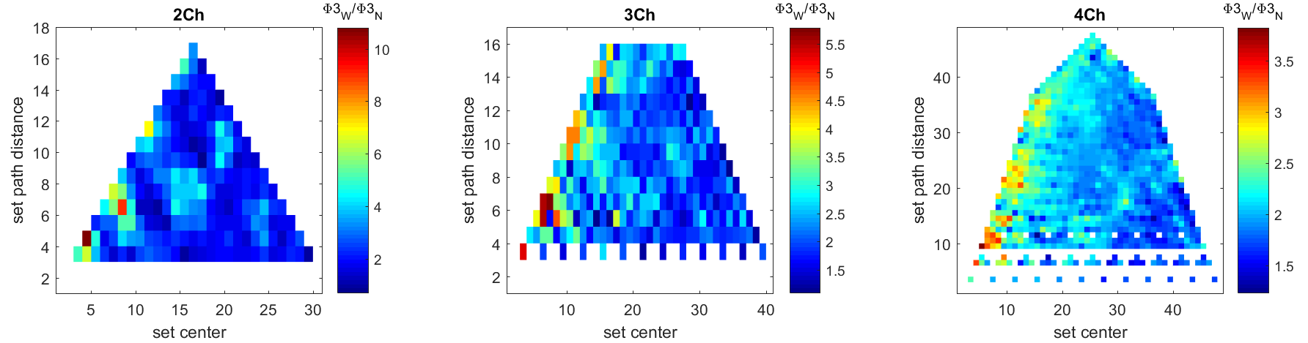
Φ^{3.0} 18s wake / anest
Notes:
Averaged across flies

Slide 52
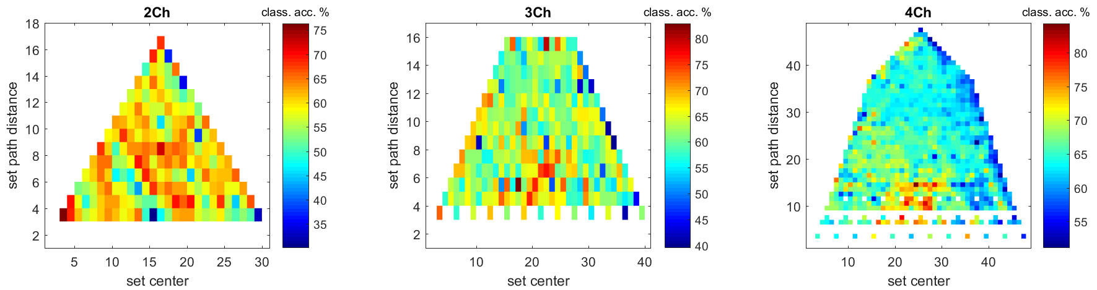
Φ^{3.0} classification across flies
Notes:
Interestingly best classification isn’t where the difference is greatest

Slide 53
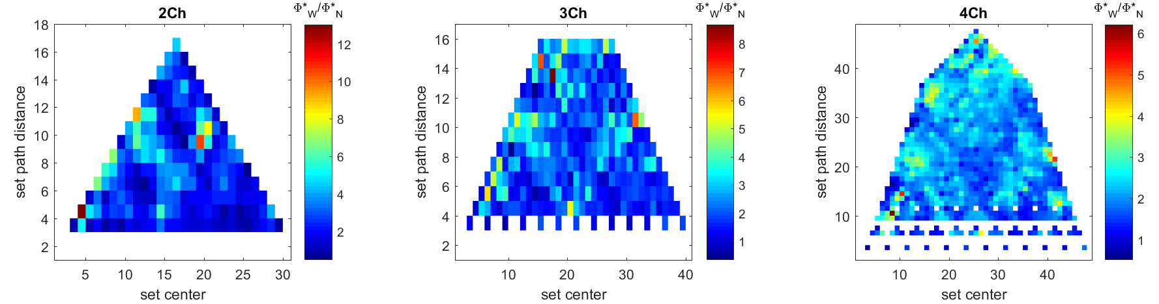
Φ* 18s wake / anest
Notes:
Averaged across flies

Slide 54
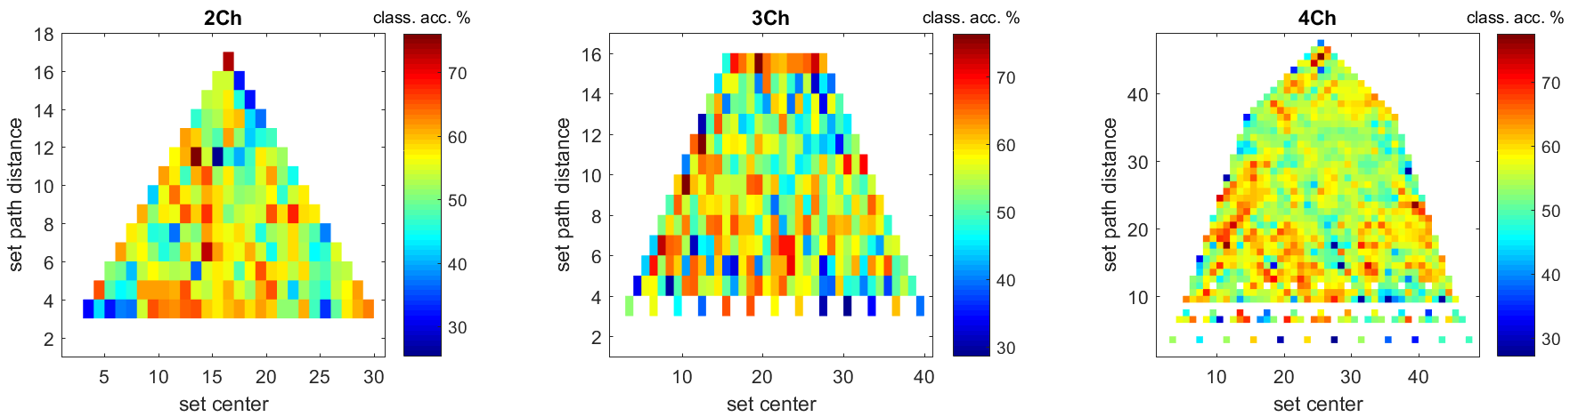
Φ* classification across flies
Notes:
Averaged across flies

Slide 55
Comparison with Power, Coherence
Power – univariate measure of activity in the frequency domain
Calculation:
3 tapers
frequency range 0-50Hz
padding = 1
Coherence – bivariate measure of synchronous activity between two channels in the frequency domain
Calculation:
5 tapers
frequency range 0-50Hz
padding = 1

Slide 56
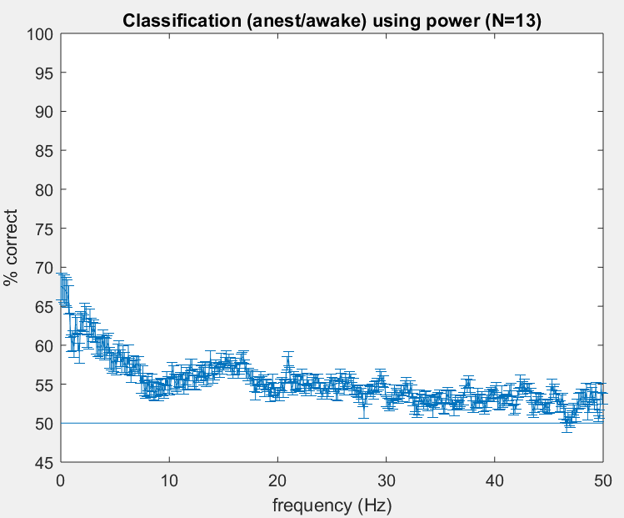
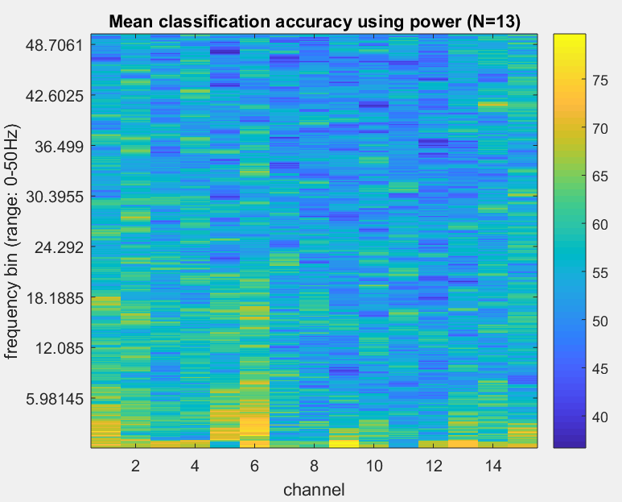
Power (across trial classification)
Notes:
Line graph is standard error across flies, after averaging across channels, then flies

Slide 57
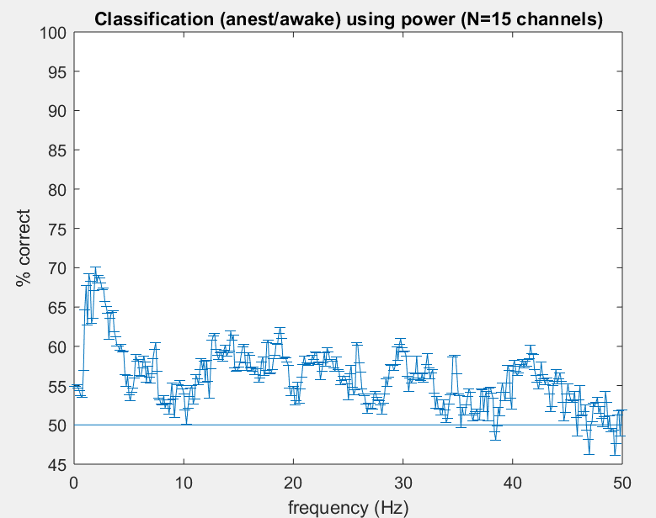
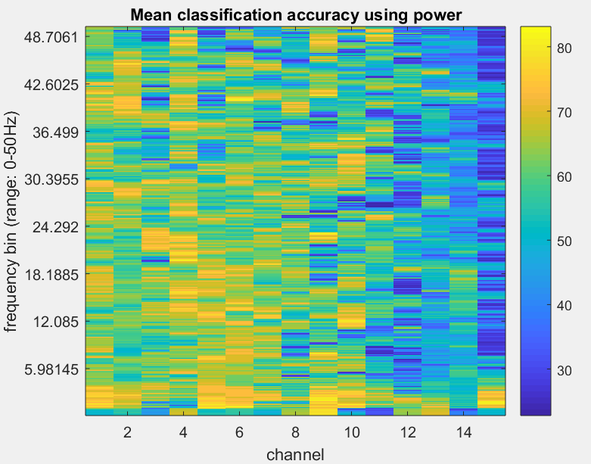
Power (across fly classification)
Notes:
Line graph is standard error across flies, after averaging across channels, then flies
Across fly classification – measure is averaged across trials to get 1 value per fly/condition

Slide 58
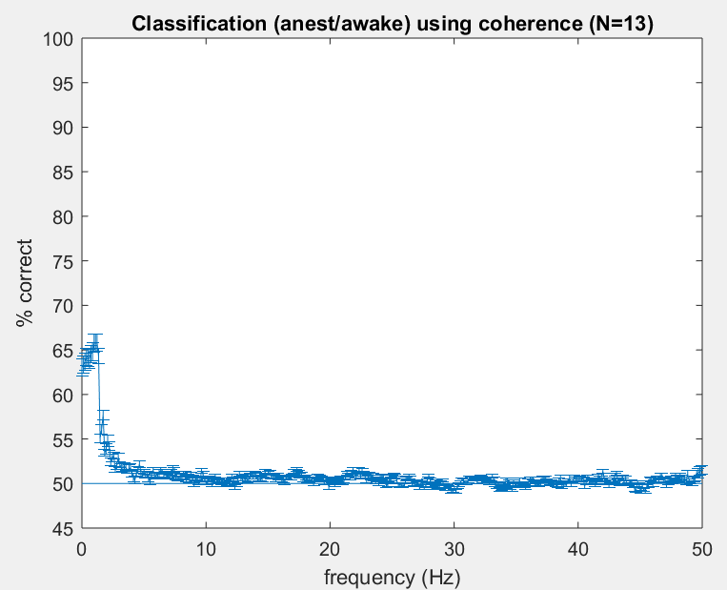
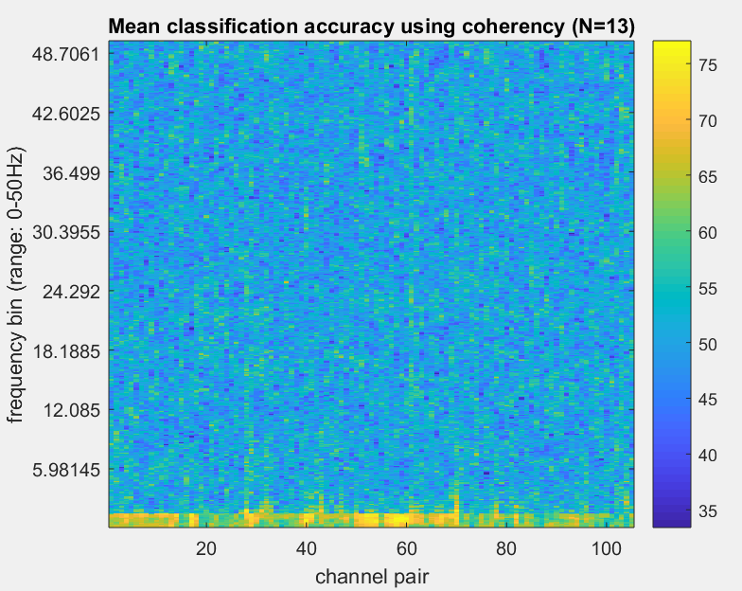
Coherence (across trial classification)

Slide 59
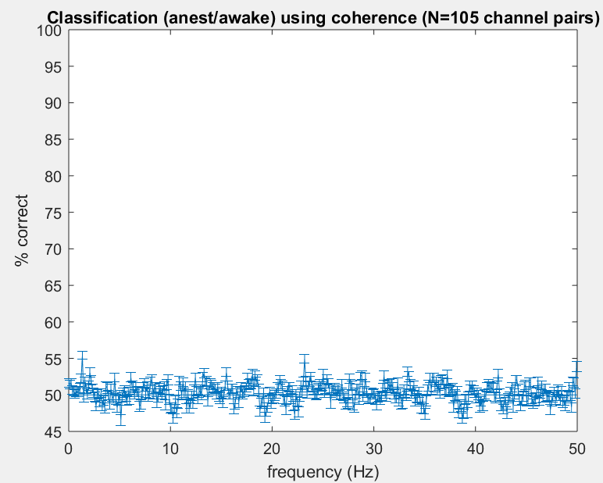
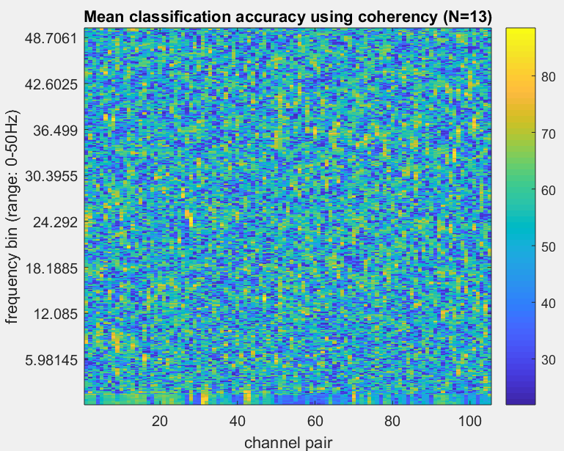
Coherence (across fly classification)

Slide 60
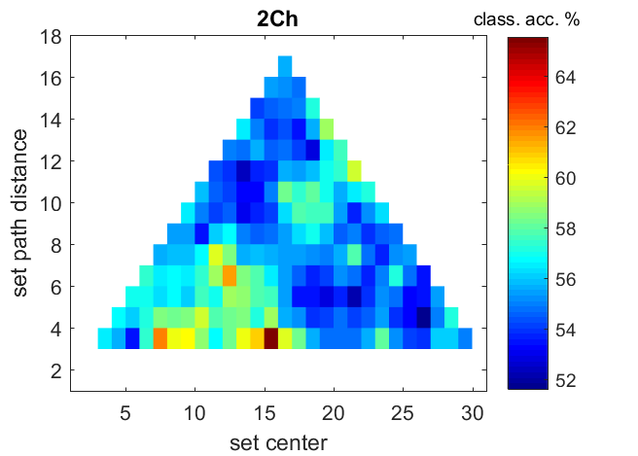
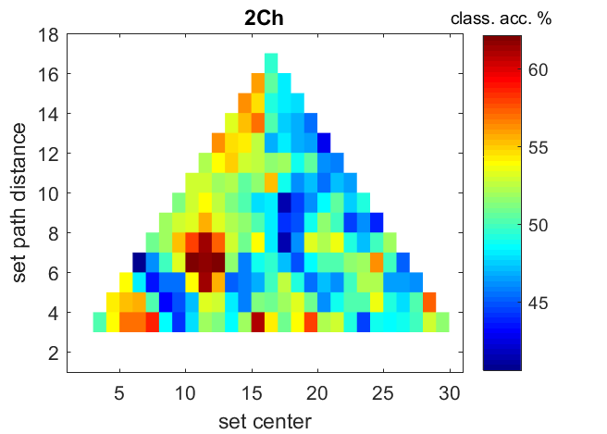
Coherence (0-5Hz)
Classification across trials
Classification across flies

Slide 61
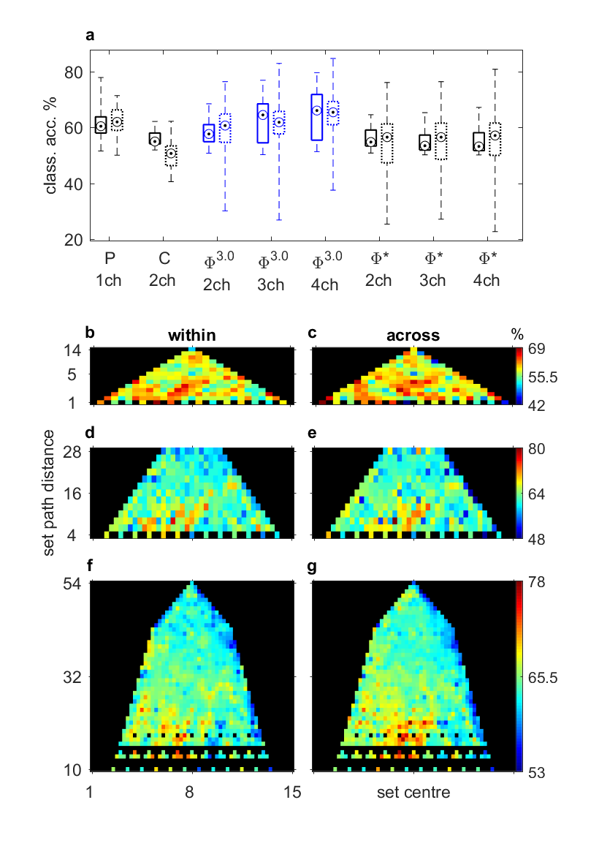
Classification summary
Notes:
Solid box – classification across trials (one value per fly, after averaging across channel sets)
Dotted box – classification across flies (one value per channel set)
Boxes are 25-75th percentiles
Whiskers are min/max
Within subject errorbars
Power – errorbar should be standard deviation – distance of 0
test for interaction between center and distance

Slide 62
Summary
Overall, clear reduction in Φ^{3.0} during anaesthesia
Φ* also reduces
Φ^{3.0} values higher in central and peripheral locations
Φ^{3.0} in periphery reduces to a larger degree under anaesthesia
Φ^{3.0} more accurate between central/peripheral locations
More accurate(?) than power, coherence, and Φ*
Pattern of power, coherence, and Φ* not so clear

Slide 63
A little extra?

Slide 64
Methodological Issues With Large Data
We ideally want Φ for a large system (e.g. a brain), but:
Computational complexity
Channel set selection
For 5 channels:
15 choose 5 = 3003 sets
50x increase in computational time from 4 channels
Way of selecting ‘best’ channel sets?

Slide 65
2-channel Φ vs 4-channel Φ
Is Φ of 4 channel sets related to Φ of 2 channel sets?
4 channel Φ vs mean of single channel Φ
Single channel Φ = average Φ across all 2-channel sets containing the channel

Slide 66
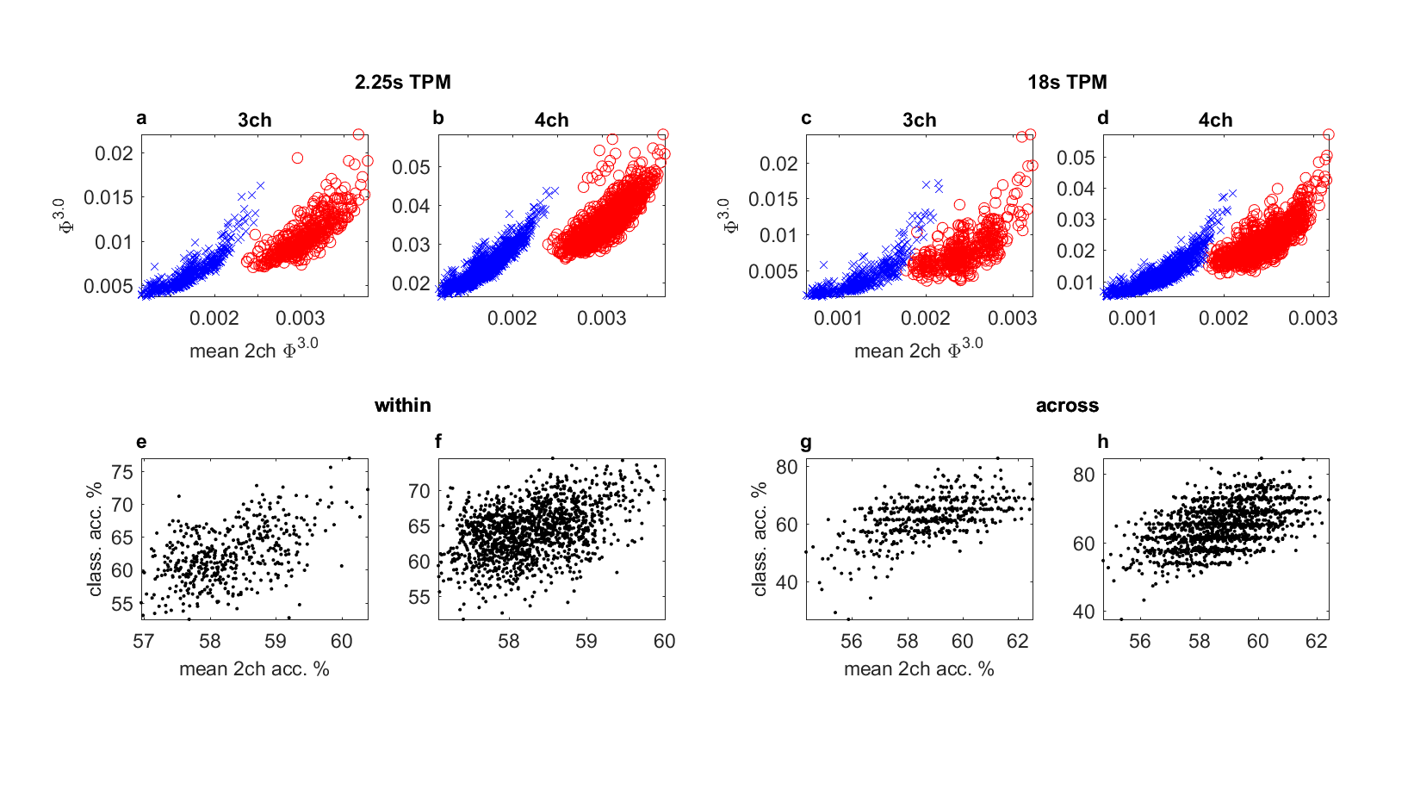
2-channel Φ^{3.0} vs 4-channel Φ^{3.0}

Slide 67
2-channel Φ^{3.0} vs 4-channel Φ^{3.0}

Slide 68
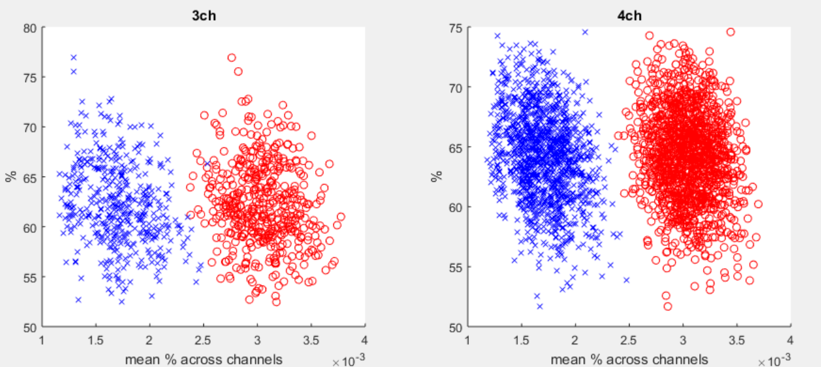
Φ^{3.0} magnitude vs Φ^{3.0} classification
Classification across trials
Notes:
But phi magnitude doesn’t seem to correlate with performance

Slide 69
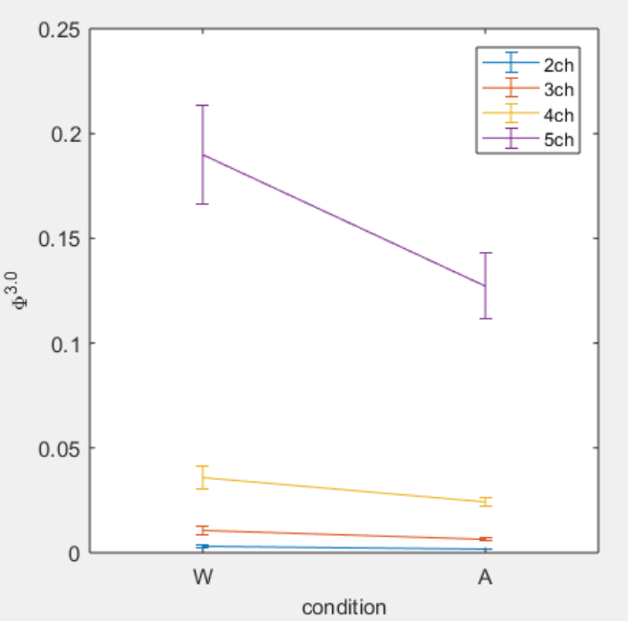
5-channel Φ
Compute Φ for 5 channels
Use channels with highest mean 2-channel Φ (wake)
Notes:
Following on from spatial pattern, best channels may not be have a reduction in phi (esp. central-tending sets)

Slide 70
That’s it
Only hidden slides from here on

Slide 71
Power and Coherence Within Fly Analysis

Slide 72
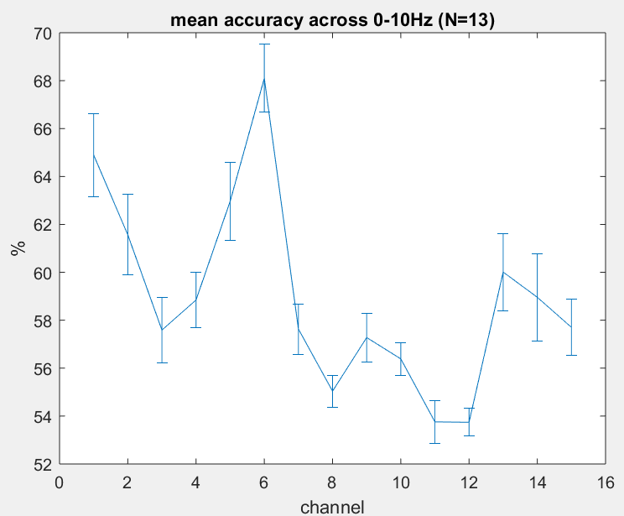
Power Classification Per Channel 0-10Hz

Slide 73
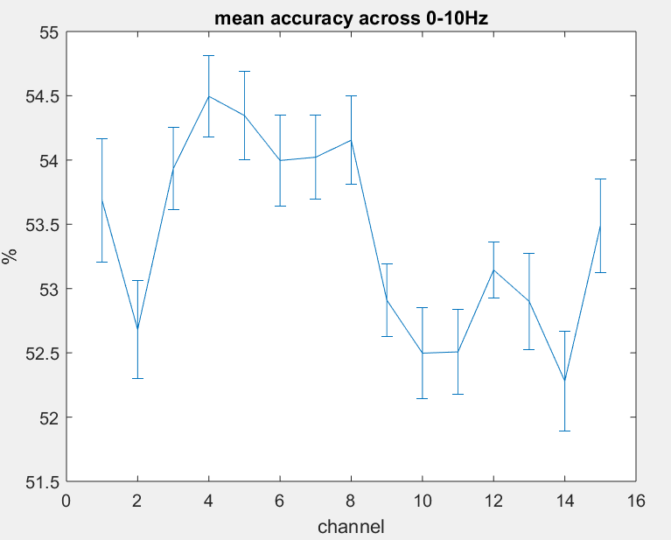
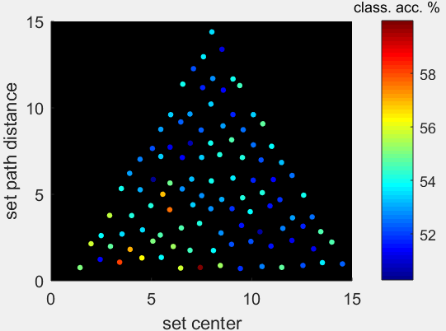
Coherence Classification Per Channel and Set Location (0-10Hz)
Value per channel = average value across all networks containing that channel
Notes:
Standard error of 13 flies

Slide 74
Power and Coherence Across Fly Analysis

Slide 75
Across Fly Analyses
Power and coherence averaged across trials (8 x 2.25s trials)
Will recompute for 18s for ‘fairer’ comparison with phi, later on
Classification is across 2 conditions x 13 flies

Slide 76
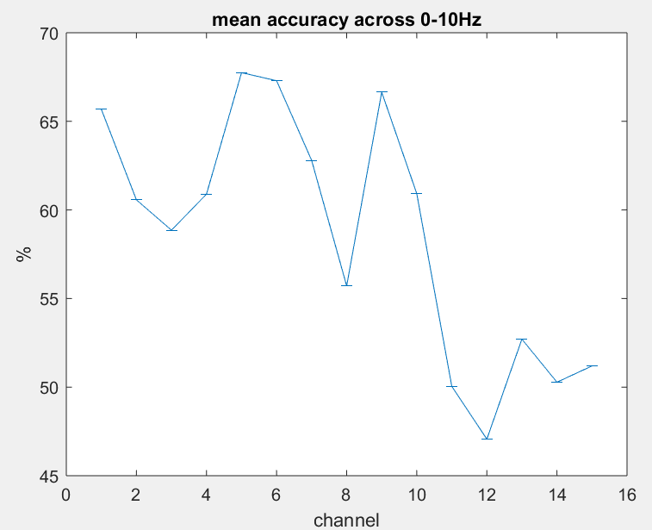
Power Classification Per Channel 0-10Hz

Slide 77
2-ch Coherence Classification

Slide 78
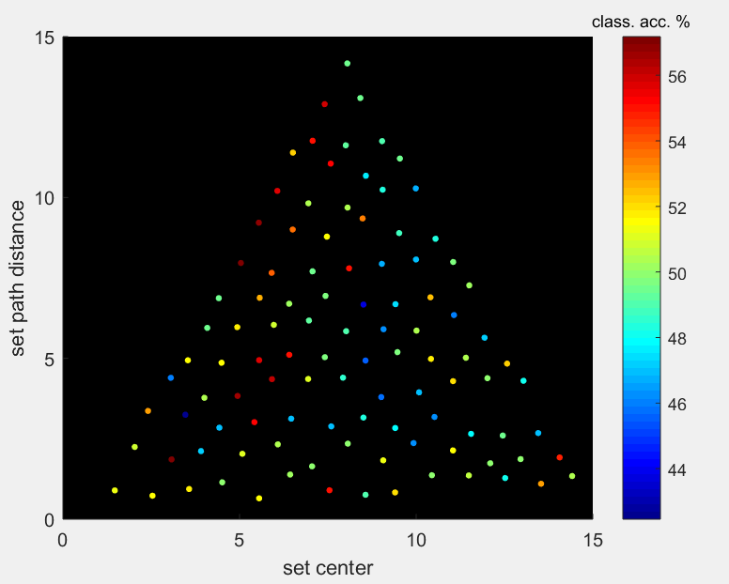
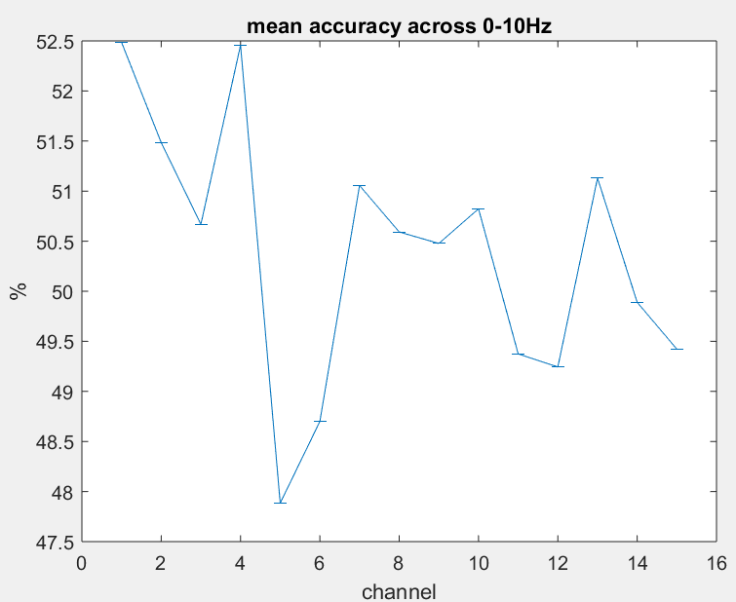
Coherence Classification Per Channel and Set Location (0-10Hz)

Slide 79
Phi-3 Within Fly Analysis

Slide 80
Within Fly Analysis
Phi-3 computed using 2 conditions x 8 trials x 2.25s TPMs
Classification is across 2 conditions x 8 trials, within fly

Slide 81
Mapping set location and globality to 2D
Goal – visualise phi-pattern in 2D space
But we have 2-, 3-, and 4-D spaces (for 2, 3, and 4 channel set combinations)
Reduction to 2 dimensions:
Location – where is the center of the set?
‘set center’
Globality – how far apart are the channels in the set?
‘set path distance’

Slide 82
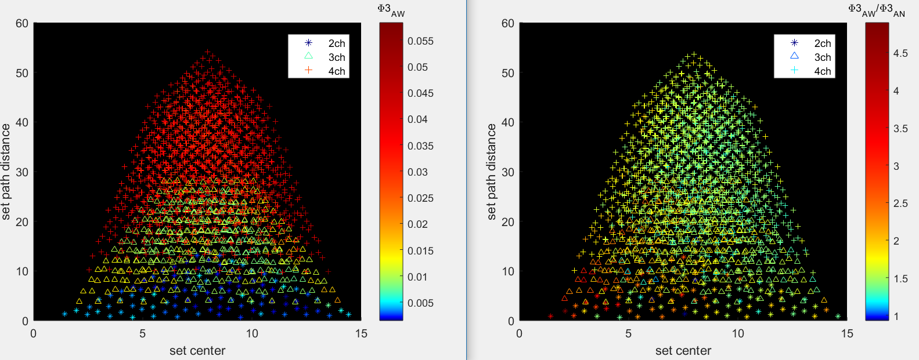
Phi-3 values using 2.25s TPM
Awake
Awake/Anest
Note: (x, y) are jittered by +-~.4 of minimum change in axis; this is due to multiple sets having the same position
Notes:
NOTE: Color axis is non-linear
NOTE: (x,y) locations (for all of these plots) are jittered randomly because some channel sets share the same (x,y) location
Jitter is just under half of the smallest step from one value to the next (+-0.1 [0.25/2] center and +-0.4 [1/2] for distance)
Averaged across 8 trials and 13 flies

Slide 83
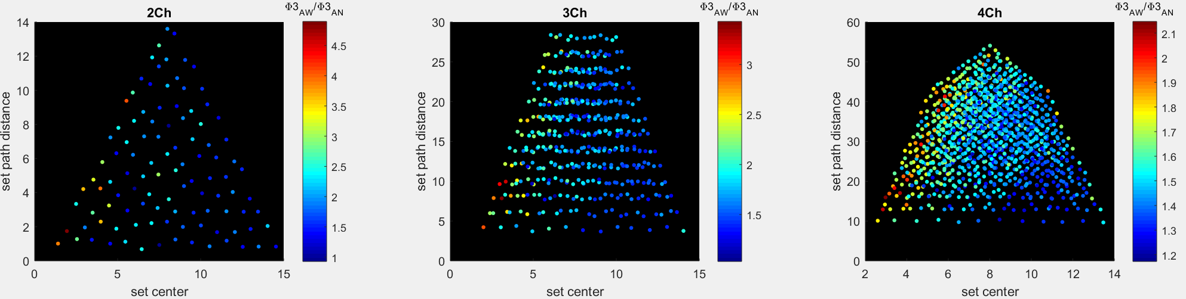
Phi-3 values using 2.25s TPM
Awake/Anest
Distance: r = -.07, p = .5
Center: r = -.55, p << .001
Distance: r = .00, p = .98
Center: r = -.57, p << .001
Distance: r = .16, p << .001
Center: r = -.51, p << .001
Notes:
Color scale here is now linear
<< means more than an order of magnitude, i.e. .0001 or less

Slide 84

Classification using 2.25s TPM Phi-3
Leave-one-out classification across 8+8 (awake+anest) trials
Distance: r = -.09, p = .36
Center: r = -.17, p = .08
Distance: r = -.32, p << .001
Center: r = -.14, p = .002
Distance: r = -.23, p << .001
Center: r = -.20, p << .001
Notes:
Color scale here is now linear
Looks like higher accuracy in the middle? (Where the set center is between the periphery and center)
Not sure how to investigate this

Slide 85

Phi-3 values and classification per channel
Notes:
Per-channel values are obtained by averaging across all channel sets in which the channel is contained
Averaged across trials, then across flies
Bars are standard error across 13 flies
Despite larger relative change between conditions, accuracy is lower for 2ch – suggests change per channel in phi is less consistent across networks within fly?

Slide 86

Phi-3 vs average of 2-ch means
W: r = .80, p << .001
A: r = .88, p << .001
W: r = .81, p << .001
A: r = .90, p << .001
Notes:
Looks like channels which contribute to phi in small networks are good for larger networks also
x-axis: each channel has an average phi value (across all networks it’s involved in, see previous slide) – x value is obtained by averaging the channel averages across channels in the channel set
y-axis: actual phi value for the channel set

Slide 87

Phi-3 classification vs 2-ch means
r = .50, p << .001
r = .42, p << .001
Notes:
Looks like channels which can be used to discriminate wake/anest are also good in larger networks

Slide 88
Phi-3 Across Fly Analysis

Slide 89
Across Fly Analysis
Phi-3 computed using 2 conditions x 18s TPMs
Classification is across 2 conditions x 13 flies

Slide 90

Phi-3 values using 18s TPM
Awake
Awake/Anest
Note: (x, y) are jittered by +-~.4 of minimum change in axis; this is due to multiple sets having the same position
Notes:
NOTE: Color axis is non-linear
NOTE: (x,y) locations (for all of these plots) are jittered randomly because some channel sets share the same (x,y) location
Jitter is just under half of the smallest step from one value to the next (+-0.1 [0.25/2] center and +-0.4 [1/2] for distance)
Averaged across 8 trials and 13 flies

Slide 91

Phi-3 values using 18s TPM
Awake/Anest
Distance: r = -.01, p = .90
Center: r = -.41, p << .001
Distance: r = .05, p = .26
Center: r = -.43, p << .001
Distance: r = .07, p = .01
Center: r = -.39, p << .001
Notes:
Color scale here is now linear
<< means more than an order of magnitude, i.e. .0001 or less

Slide 92

Classification values using 18s TPM
Awake/Anest
Distance: r = -.01, p = .94
Center: r = -.14, p = .15
Distance: r = -.10, p = .03
Center: r = -.13, p = .005
Distance: r = .18, p << .001
Center: r = -.21, p << .001
Notes:
Color scale here is now linear

Slide 93

Phi-3 values and classification per channel
Notes:
Averaged across trials, then across flies
Bars are standard error across 13 flies
Despite larger relative change between conditions, accuracy is lower for 2ch – suggests change per channel in phi is less consistent across networks within fly?
Errorbars in bottom right are 0 – because we are classifying across 13 flies

Slide 94

Phi-3 vs average of 2-ch means
W: r = .68, p << .001
A: r = .83, p << .001
W: r = .79, p << .001
A: r = .88, p << .001
Notes:
Looks like channels which contribute to phi in small networks are good for larger networks also

Slide 95

Phi-3 classification vs 2-ch means
r = .57, p << .001
r = .51, p << .001
Notes:
Looks like channels which can be used to discriminate wake/anest are also good in larger networks

Slide 96
Phi-star Within Fly Analysis

Slide 97
Within Fly Analysis
Phi-star computed using 2 conditions x 8 trials x 2.25s covariances
Classification is across 2 conditions x 8 trials, within fly

Slide 98

Phi-star values using 2.25s TPM
Awake
Awake/Anest
Note: (x, y) are jittered by +-~.4 of minimum change in axis; this is due to multiple sets having the same position
Notes:
NOTE: Color axis is non-linear
NOTE: (x,y) locations (for all of these plots) are jittered randomly because some channel sets share the same (x,y) location
Jitter is just under half of the smallest step from one value to the next (+-0.1 [0.25/2] center and +-0.4 [1/2] for distance)
Averaged across 8 trials and 13 flies

Slide 99

Phi-star values using 2.25s TPM
Awake/Anest
Distance: r = .04, p = .65
Center: r = -.12, p = .23
Distance: r = .10, p = .03
Center: r = .05, p = .31
Distance: r = .06, p = .02
Center: r = .08, p = .004
Notes:
Color scale here is now linear
<< means more than an order of magnitude, i.e. .0001 or less

Slide 100

Classification using 2.25s TPM Phi-star
Leave-one-out classification across 8+8 (awake+anest) trials
Distance: r = -.41, p << .001
Center: r = .12, p = .21
Distance: r = -.22, p << .001
Center: r = .06, p = .23
Distance: r = -.14, p << .001
Center: r = .04, p = .10
Notes:
Color scale here is now linear
Looks like higher accuracy in the middle? (Where the set center is between the periphery and center)
Not sure how to investigate this

Slide 101

Phi-star values and classification per channel
Notes:
Averaged across trials, then across flies
Bars are standard error across 13 flies
Phi axis is smaller for phi-star than for phi-3

Slide 102

Phi-star vs average of 2-ch means
W: r = .26, p << .001
A: r = .26, p << .001
W: r = .29, p << .001
A: r = .28, p << .001
Notes:
Looks like channels which contribute to phi in small networks are good for larger networks also

Slide 103

Phi-star classification vs 2-ch means
r = .36, p << .001
r = .31, p << .001
Notes:
Looks like channels which can be used to discriminate wake/anest are also good in larger networks

Slide 104
Phi-star Across Fly Analysis

Slide 105
Across Fly Analysis
Phi-star computed using 2 conditions x 18s covariances
Classification is across 2 conditions x 13 flies

Slide 106

Phi-star values using 2.25s TPM
Awake/Anest
Distance: r = .15, p = .11
Center: r = -.24, p = .01
Distance: r = .19, p << .001
Center: r = -.12, p = .03
Distance: r = .17, p << .001
Center: r = -.05, p = .04
Notes:
Color scale here is now linear
<< means more than an order of magnitude, i.e. .0001 or less

Slide 107

Classification using 2.25s TPM Phi-star
Leave-one-out classification across 8+8 (awake+anest) trials
Distance: r = -.08, p .44
Center: r = .01, p = .90
Distance: r = -.04, p = .43
Center: r = -.10, p = .03
Distance: r = -.00, p = .96
Center: r = -.07, p = .01
Notes:
Color scale here is now linear
Looks like higher accuracy in the middle? (Where the set center is between the periphery and center)
Not sure how to investigate this

Slide 108

Phi-star values and classification per channel
Notes:
Averaged across trials, then across flies
Bars are standard error across 13 flies
Phi axis is smaller for phi-star than for phi-3
Errorbars in bottom right are 0 – because we are classifying across 13 flies

Slide 109

Phi-star vs average of 2-ch means
W: r = .25, p << .001
A: r = .26, p << .001
W: r = .25, p << .001
A: r = .27, p << .001
Notes:
Looks like channels which contribute to phi in small networks are good for larger networks also

Slide 110

Phi-star classification vs 2-ch means
r = .34, p << .001
r = .30, p << .001
Notes:
Looks like channels which can be used to discriminate wake/anest are also good in larger networks

